Slide 1
Project Title
SheShield: A Moral Tech Solution for Women’s Protection
Team Members :RAMYA M(2023PECCS341)
PAVITHRA E(2023PECCS305)
Guide Name:Mr.Ramana R
Co-ordinator Name:Mr.Elangovan C,
Mrs.JaichitraVasudevan I,
Mr.Ravindran U.
Batch No:12

Slide 2
DOMAIN : Internet of Things (IoT) and Cloud Computing
SDG Goal:
SDG 5 – Gender Equality
SDG 11 – Sustainable Cities and Communities
Relevant Target:
Target 5.2: Eliminate all forms of violence against all women and girls in the public and private spheres
Target 11.7: Provide safe, inclusive and accessible public spaces, especially for women and children

Slide 3
Base Paper
IoT-Based Women Safety Device Using Haversine Formula
Md Abu Talha; Mehedi Hasan; Mohammad Abdul Mannan; Shameem Ahmad; Md Rifat Hazari; Md Shahriar Parvez; Tamim Hossain; Sanjid Islam2025 4th International Conference on Robotics, Electrical and Signal Processing Techniques (ICREST)Year: 2025 |Conference Paper |Publisher:IEEE

Slide 4
ABSTRACT
SheShield is a women’s safety Android application designed to provide rapid assistance in emergencies through features such as SOS alerts, real-time GPS location sharing, and audio/video evidence recording. It ensures reliability even in areas with poor or no internet connectivity via SMS-based notifications. Developed using Android SDK, Firebase, and native device APIs, the app allows users to predefine trusted contacts who receive instant alerts with precise location data upon SOS activation. With its intuitive interface, offline capability, and integrated safety tools, SheShield offers a proactive, accessible, and technology-driven solution for enhancing women’s personal security.

Slide 5
Social Relevance
Benefits to Society:
SheShield is designed to tackle one of the most urgent issues today – women’s safety. It provides a quick, dependable way to get help in emergencies through real-time location sharing, instant alerts, and audio/video evidence recording. This not only helps women feel more secure but also reduces the time it takes for help to arrive. The app encourages safe mobility, builds public awareness, and promotes the use of technology for social protection.
Link to UN Sustainable Development Goals (SDGs):
The project supports several UN SDGs:
SDG 5-gender equality:Empowering womens safety
SDG 11 – Sustainable Cities & Communities: Helps make cities safer and more inclusive.

Slide 6
INTRODUCTION
Background Study:
Women’s safety has been a serious concern for many years, and the rise in incidents such as harassment, assault, and other crimes has made it a pressing issue. While measures like helplines, police patrols, and community awareness programs exist, they often fail to provide help at the exact moment it is needed. With the growth of smartphones, GPS, and IoT technologies, we now have the chance to build smarter, faster, and more reliable safety systems. These technologies make it possible to send instant alerts, share real-time locations, and even record evidence during emergencies — all from a single mobile app.

Slide 7
Motivation for the Project:
The idea for SheShield came from the need to give women a safety tool they can trust anytime, anywhere. Many existing safety apps work only with internet access or have complicated features, making them difficult to use in emergencies. SheShield is designed to solve these problems by providing SOS alerts, live GPS location sharing, and offline SMS notifications in one simple and user-friendly application. Our motivation is to use technology not just for convenience, but to help create a society where women feel safe, confident, and empowered to move freely without fear.

Slide 8
LITERATURE SURVEY
1. G. Uganya, N. Kirubakaran, Besnatin T., M. Boobalan — Smart Women Safety Device using IoT and GPS Tracker (ICREST / IEEE, 2023)
Summary / Contribution: Presents a compact IoT-based safety device that uses GPS and GSM modules to locate and alert guardians via SMS. The work demonstrates a wearable/portable approach to personal safety with basic geo-tracking and alerting features.
Limitations: Focuses on hardware alerts and lacks integrated multimedia evidence capture, advanced location analytics, or smartphone-side UI/UX.
Relation to SheShield: Inspires SheShield’s offline SMS fallback and IoT-aware thinking; SheShield extends this idea by integrating smartphone media capture, cloud sync, and safe-route features.
2. Yogesh C., Vatchala S. — Empowering Women’s Safety: An Innovative Smart Security System (ICRTAC / IEEE, 2023)
Summary / Contribution: Describes a holistic safety system combining mobile alerts, location sharing, and simple analytics to support rapid response. Emphasizes usability and low-cost deployment.
Limitations: May not deeply address offline reliability or evidence handling, nor propose prevention (danger-zone) features.
.

Slide 9
3. Mani Gupta, Rashmi Ashtt, Monali Wankar, Ajay Monga — Speech Recognition Applications in Enhancing Safety for Women in Built Environment (OSDA / IEEE, 2023)
Summary / Contribution: Investigates speech-recognition approaches for safety—keyword detection, on-device vs. cloud recognition—and use-cases where voice triggers improve accessibility.
Limitations:Speech models can suffer from false triggers and may need language/local accent adaptation; cloud solutions depend on connectivity.
Relation to SheShield: Informs SheShield’s voice-trigger module design choices (on-device recognition for offline resilience, sensitivity tuning to reduce false positives).
4. Md Abu Talha et al. — IoT-Based Women Safety Device Using Haversine Formula (IREST / IEEE, 2025)
Summary / Contribution: Uses geospatial computation (Haversine) for distance checks and alerts, showing how proximity to known risk points can be detected reliably on resource-constrained devices.
Limitations: Focuses on geolocation math; may not address media capture, user experience, or messaging fallback.
Relation to SheShield: Directly relevant for SheShield’s danger-zone detection and safe-route algorithm (distance calculation + geofencing logic)
🔹 .

Slide 10
5. T. Sen, A. Dutta, S. Singh, V. Naveen Kumar — ProTecht – Implementation of an IoT based 3-Way Women Safety Device (ICECA / IEEE, 2024)
Summary / Contribution: Demonstrates a hardware solution with three redundancy channels (SMS, voice call, app alert), improving chances of notification under varying network conditions.
Limitations:Hardware-first approach may lack rich smartphone features (video/audio capture, map-based rerouting) and cloud integration.
Relation to SheShield:
Motivates SheShield’s emphasis on multi-channel alerting and robust fallback (SMS + cloud notifications) while adding richer evidence collection.
6. Athira K., Sriharsha R., Rajkumar N. — Women’s Safety in Cities Using Android (SAS / IEEE, 2023)
Summary / Contribution: Describes an Android app prototype for urban safety: location sharing, SOS messages, and UI considerations for ease-of-use in city contexts.
Limitations:Primarily urban-focused; may not handle poor-network, multimedia evidence, or prevention features.
Relation to SheShield:Validates the mobile-app approach and UI simplicity—SheShield extends to offline operation and evidence capture for broader applicability.
🔹 .

Slide 11
7. S. Saxena, R. S. Rajpurohit, A. K. Yadav — IoT-Based Women Safety Gadgets (WSG): Vision, Architecture, and Design Trends (Computers, Materials & Continua, 2023)
Summary / Contribution: A review-style paper summarizing IoT safety gadget architectures, common sensors, connectivity options, and design trade-offs. Useful for understanding ecosystem trends.
Limitations:Survey rather than a single-system evaluation; highlights gaps without full implementation details.
Relation to SheShield: Helps justify design choices (sensor selection, offline fallback), and positions SheShield within current device+app hybrid trends.
8. M. Parameswaran, N. Dayal, V. Sandhiya, Sneha K. — *I-SWSS: IoT Enabled Smart Women Safety System(ICCCI / IEEE, 2024)
Summary / Contribution: Presents an IoT-enabled framework tying sensors (GPS, GSM) to cloud alerts; includes real-time tracking and caregiver notification features.
Limitations:Focus may be infrastructure-heavy; potential gaps in media/evidence capture and UX polishing.
Relation to SheShield: Reinforces importance of cloud backend and caregiver notification flows; SheShield improves by unifying media capture and offline SMS fallback.
🔹 .

Slide 12
9. N. Kirthiga, Sudharshan, Hruthika Reddy — A Novel Women Safety Android Application (ICUIS / IEEE, 2024)
Summary / Contribution: Prototype Android application focusing on quick SOS, contact alerts, and basic tracking; emphasizes minimal-user-action design.
Limitations:May lack advanced modules like voice activation, danger-zone prevention, or media capture.
Relation to SheShield:Confirms importance of minimal-step SOS flow; SheShield incorporates that usability while adding richer feature set.
10. M. Anand Gopalakrishnan, S. R. Kannan, P. P. Kumar — AI-Based Smart Wearable Safety System for Women (IConIC / AIP Proc., published 2023)
Summary / Contribution: Describes a wearable + AI pipeline for anomaly detection (e.g., falls, sudden motion) and automated alerting via IoT cloud.
Limitations: Wearable-focused systems must address battery life, false positives, and continuous connectivity; also may not capture audio/video evidence.
Relation to SheShield: Inspires potential enhancement routes (wearable integration, AI-based triggers) while SheShield focuses initially on smartphone-based, offline-resilient solutions.
🔹 .

Slide 13
11. M. Woodburn et al. — Herd Routes: A Preventative IoT-Based System for Improving Female Pedestrian Safety (arXiv, 2024)
Summary / Contribution: Proposes preventive routing concepts that favor “herd” or safer pedestrian flows and evaluates route-safety metrics.
Limitations:Preprint / non-IEEE, but conceptually useful; practical deployment challenges exist (data availability, privacy).
Relation to SheShield: Directly relevant to SheShield’s safe-path suggestion and danger-zone avoidance—useful for route scoring and recommendation logic.
12. S. Farooq, S. Rehman, M. H. Rehman — The Role of IoT in Women’s Safety: A Systematic Literature Review (IEEE Access, 2023)
Summary / Contribution: Systematic review highlighting the landscape of IoT-based safety solutions, common sensors, communication methods, and research challenges.
Limitations: As a review, it synthesizes but does not implement system prototypes.
Relation to SheShield: Provides evidence for choices like SMS fallback and multi-sensor integration; highlights open problems SheShield addresses (evidence workflow, offline operation).

Slide 14
13. P. Ramesh, N. Dayal, V. Sandhiya, Sneha K. — IoT-Enabled Smart Safety Alert System for Women (TENSYMP / IEEE Region 10, 2023)
Summary / Contribution: Regionally-focused IoT alert system demonstrating real-time alerts, cloud notification, and basic analytics for caregivers.
Limitations: Might emphasize infrastructure/region specifics; may not integrate media capture or offline SMS fallback comprehensively.
Relation to SheShield:Supports the cloud-backed alerting model; SheShield complements by ensuring offline resilience and media evidence handling.
14. R. Sharma, V. A. Borkar — Smart Security Device for Women Safety Using GPS and GSM (ICAC3 / IEEE, 2023)
Summary / Contribution: Demonstrates GPS+GSM-based wearable or device capable of sending SOS messages with coordinates to pre-configured numbers.
Limitations:Focus on basic location alerts; often lacks smartphone app features, safe-route suggestions, and evidence capture.
Relation to SheShield: Validates the GPS+SMS fallback approach—SheShield extends that with richer app features and cloud integration.
🔹 .

Slide 15
15. K. Bhanu Priya, S. Revathi, R. Anitha — Design and Implementation of Women Safety Device Using Arduino and GPS (STSD / IEEE, 2024)
Summary / Contribution: Low-cost Arduino-based prototype for location tracking and automated alerts; useful for grassroots, low-budget deployments.
Limitations: Hardware prototypes often lack polished UX and are limited in media/evidence capture and smartphone convenience.
Relation to SheShield: Useful precedent for low-cost solutions; SheShield leverages smartphone ubiquity to deliver richer functionality without extra hardware.
16. T. Anjali, M. Rakesh, V. Jayasree — Smart Wearable Device for Women Safety with Live Tracking and Alerting System (ICIRCA / IEEE, 2023)
Summary / Contribution: Presents a wearable with live-tracking and immediate alerting; highlights design considerations for wearability and immediate notification.
Limitations:Challenges include battery, continuous connectivity, and limited on-device processing for media capture.
Relation to SheShield: Suggests future integration points for SheShield (wearable-triggered SOS) while SheShield focuses on smartphone-first, multi-feature approach.
🔹 .

Slide 16
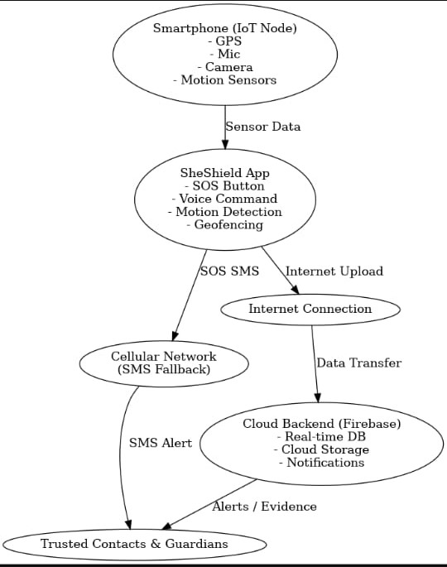
ARCHITECTURE

Slide 17
Proposed System:
The SheShield application is designed to provide quick, reliable, and accessible safety measures for women in emergencies. It integrates multiple modules such as SOS alerts, GPS tracking, safe-route suggestions, and evidence capture, ensuring functionality in both online and offline environments.
The architecture, as shown in the diagram, consists of the following key components:
Smartphone (IoT Node):
Equipped with GPS, microphone, camera, and motion sensors to collect real-time data.
Acts as the primary device for user interaction and emergency alerts.
SheShield App:
Core application installed on the smartphone.
Features include SOS button, voice command activation, motion detection, and geofencing.
Processes sensor data and triggers appropriate actions.

Slide 18
Internet Connection & Cellular Network (SMS Fallback):
Internet is used to upload location and evidence to the cloud in real time.
If the internet is unavailable, the system switches to SMS-based alerts to reach trusted contacts
.
Cloud Backend (Firebase):
Stores real-time location, media evidence, and notification logs.
Provides authentication, data synchronization, and secure storage.
Trusted Contacts & Guardians:
Predefined contacts who receive alerts, location details, and evidence during emergencies.
Receive updates through SMS or cloud notifications.

Slide 19
Hardware Requirements:
* Processor: Intel i3 or higher / AMD equivalent
* RAM: Minimum 8 GB
* Storage: 500 GB or more
* Operating System: Windows 10 / macOS / Linux.
Mobile Device for Testing:
* Android smartphone (Android 8.0 or higher)
* Built-in GPS module
* Camera (front and rear)
* SMS functionality
* Internet connectivity (Wi-Fi / Mobile Data)

Slide 20
Software Requirements:
Development Tool:
* Android Studio (latest stable version)
* Java JDK (version 8 or above)
* Gradle build system
Programming Languages:
* Java / Kotlin for Android app development

Slide 21
MODULES
1. User Registration and Authentication Module
2. SOS Alert Module
3. Location Tracking Module
4. Audio Evidence Recording Module
5.Video Evidence Recording Module
6.Trusted contacts module
7.Offline SMS support
8.Setting permission module

Slide 22
1. User Authentication Module
Purpose: Secure user login and access.
Tools Used: Firebase Authentication
Basic Features:
Email/password login
Forgot password
Session management
Enhanced Functionality:
🔐 OTP-based login (email/phone)
🔑 2-Factor Authentication for admin
👥 User roles (user/admin)
📧 Email verification before full access
2. SOS Emergency Alert Module
Purpose: Sends real-time alerts with location.
Tools Used: SMS Manager API, GPS
Basic Features:
One-tap SOS trigger

Slide 23
Sends Google Maps location
Offline SMS support
Enhanced Functionality:
🕹️ Power button long-press trigger (mobile app)
📷 Auto image capture via front cam
🔄 Retry alert if SMS fails
⏳ Cooldown timer to prevent multiple triggers
3. Location Tracking Module
Purpose: Monitors real-time location.
Tools Used: FusedLocationProvider Client
Basic Features:
Live location tracking
GPS-based location sharing
Battery optimization
Enhanced Functionality:
🗺️ Route mapping (with polyline)
🧾 Periodic location log to Firebase
🚧 Geo-fence alerts (enter/exit safe zone)
🛰️ Save last location on signal loss

Slide 24
4. Audio Recording Module
Purpose: Records evidence in emergencies.
Tools Used: MediaRecorder API
Basic Features:
One-click audio record
Local file storage
Enhanced Functionality:
⏱️ Timed recording (30-60 secs)
☁️ Upload to Firebase + share link
🔊 Background audio capture
🔐 File encryption before upload
5. Video Recording Module
Purpose: Captures video proof discreetly.
Tools Used: Camera API or MediaStore
Basic Features:
One-click camera launch
Front or rear camera access
Local video save

Slide 25
Enhanced Functionality:
🎞️ Auto video (15–30 sec) on SOS
📡 Upload to Firebase or Drive
🔕 Silent video mode (no preview)
🔐 Timestamp + user ID watermark
6. Trusted Contacts Module
Purpose: Maintains emergency contact list.
Tools Used: Firebase Database / SharedPreferences
Basic Features:
Add/edit/remove contacts
Auto-notify all during alert
Enhanced Functionality:
🧠 AI suggestion from call history
🔔 Re-confirm trusted contacts
📡 Cloud sync of contacts
📞 One-tap call to preferred contact

Slide 26
7. Offline SMS Support Module
Purpose: Ensures alerts without internet.
Tools Used: SMS Manager API
Basic Features:
Cellular-based SMS alert
Location and message content
Enhanced Functionality:
🔁 Retry SMS in background
📜 Include timestamp + user ID
🔢 Up to 5 contact numbers
🔐 Obfuscate message for privacy

Slide 27
8. Settings and Permissions Module
Purpose: Manage app permissions and features.
Tools Used: Android Permissions API
Basic Features:
Control app features
Request app permissions
Enhanced Functionality:
🎛️ Toggle individual modules
⚠️ Alert for battery optimization restrictions
🔐 Permission status checker with auto-fix
☁️ Export/import settings from cloud

Slide 28
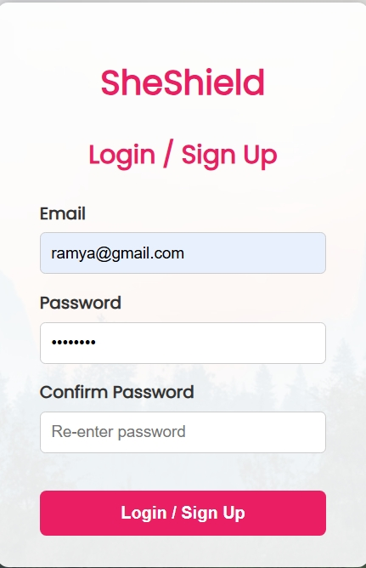
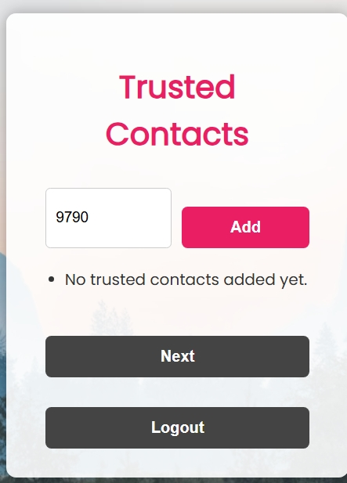
screenshots:

Slide 29

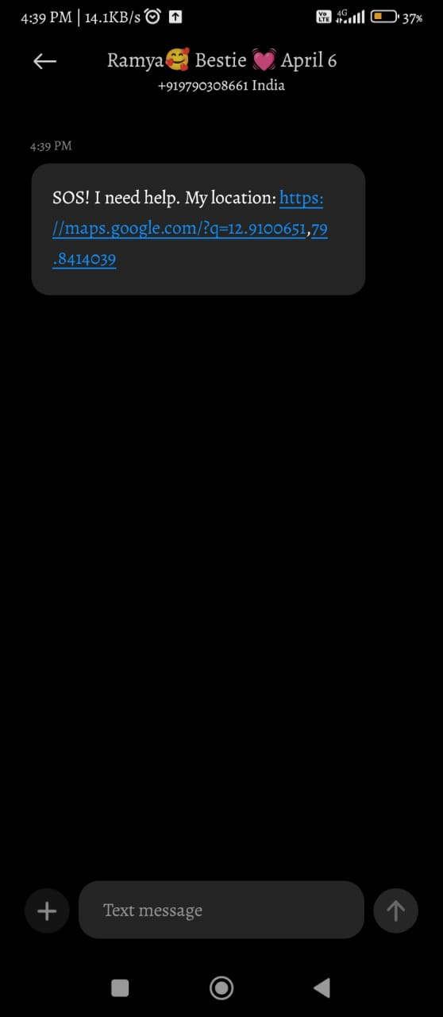
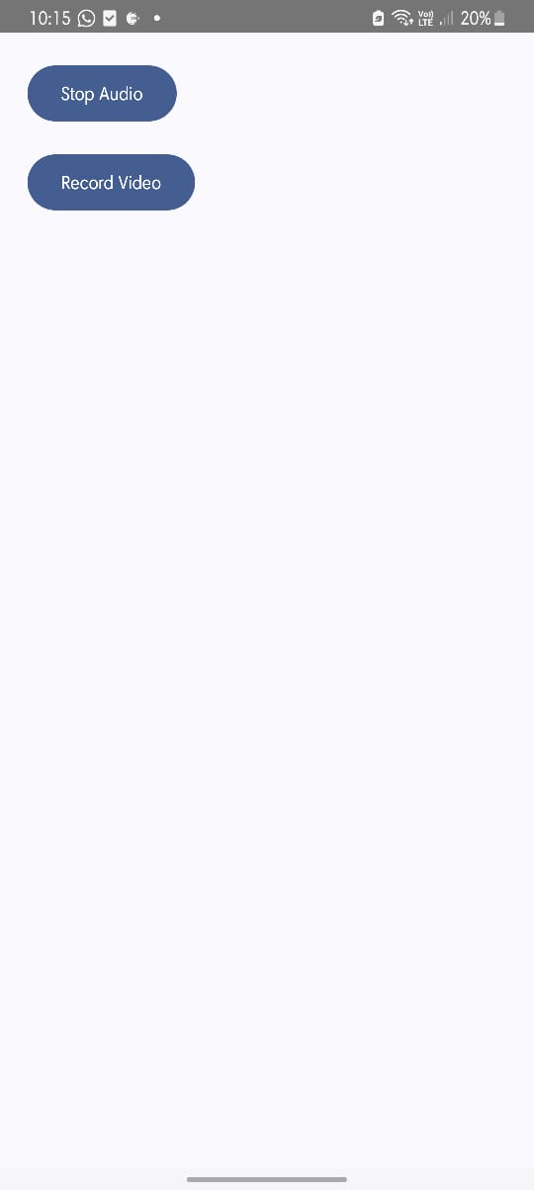

Slide 30
Future Scope / Vision
Future Scope / Vision
Wearable IoT: Add smart bands, bracelets for quicker SOS.
AI/ML: Smart panic detection, auto danger zone updates.
Community Alerts: Nearby users can help instantly.
Police Link: Direct alerts to local authorities.
Evidence Vault: Secure cloud storage for legal proof.
Expand Platforms: iOS, web, smartwatch versions.
Collaborations: NGOs, CSR, government safety schemes.
Vision
“Empower women with smart, connected safety — anytime, anywhere — supporting safer communities and SDGs.”

Slide 31
CONCLUSION:
SheShield is a complete women’s safety solution that combines SOS alerts, real-time GPS tracking, danger zone detection, and evidence recording in a single mobile app. Its ability to work both online and offline ensures help is always within reach, even in poor network areas. By integrating modern mobile and IoT technologies, SheShield not only provides immediate assistance in emergencies but also empowers women to feel safer and more confident in their daily lives.

Slide 32
References
1. Smart Women Safety Device using IoT and GPS Tracker
G. Uganya, N. Kirubakaran, Besnatin T, M. Boobalan – 2023 International Conference on Intelligent Computing and Control for Engineering, IEEE.
2. Empowering Women's Safety: An Innovative Smart Security System
Yogesh C, Vatchala S – 2023 6th International Conference on Recent Trends in Advance Computing (ICRTAC), IEEE.
3. Speech Recognition Applications in Enhancing Safety for Women in Built Environment
Mani Gupta, Rashmi Ashtt, Monali Wankar, Ajay Monga – 2023 26th Conference of the Oriental COCOSDA, IEEE.
4. IoT-Based Women Safety Device Using Haversine Formula
Md Abu Talha, Mehedi Hasan, Mohammad Abdul Mannan, Shameem Ahmad, Md Rifat Hazari, Md Shahriar Parvez, Tamim Hossain, Sanjid Islam – 2025 4th International Conference on Robotics, Electrical and Signal Processing Techniques (ICREST), IEEE.

Slide 33
5. ProTecht – Implementation of an IoT based 3-Way Women Safety Device
Trisha Sen, Arpita Dutta, Shubham Singh, Vaegae Naveen Kumar – 2024 3rd International Conference on Electronics, Communication and Aerospace Technology (ICECA), IEEE.
6.Women's Safety in Cities Using Android
Athira K, Sriharsha R, Rajkumar N – 2023 International Conference on Self Sustainable Artificial Intelligence Systems (ICSSAIS), IEEE.
7. IoT-Based Women Safety Gadgets (WSG): Vision, Architecture, and Design Trends
S. Saxena, R. S. Rajpurohit, A. K. Yadav – Computers, Materials & Continia, 2023.
8. I-SWSS: IoT Enabled Smart Women Safety System
M. Parameswaran, N. Dayal, V. Sandhiya, Sneha K – 2024 International Conference on Computing, Communication and Networking Technologies (ICCCI), IEEE.

Slide 34
9. The Role of IoT in Women’s Safety: A Systematic Literature Review
S. Farooq, S. Rehman, M. H. Rehman – IEEE Access, 2023.
10. A Novel Women Safety Android Application
N. Kirthiga, Sudharshan, H. Reddy – 2024 International Conference on Ubiquitous and Intelligent Systems (ICUIS), IEEE.
11. AI-Based Smart Wearable Safety System for Women
M. A. Gopalakrishnan, S. R. Kannan, P. P. Kumar – 2023 International Conference on Intelligent Computing (IConIC), IEEE.
12. Herd Routes: A Preventative IoT-Based System for Improving Female Pedestrian Safety
M. Woodburn, et al. – arXiv preprint arXiv:2203.01792, 2022.

Slide 35
13.IoT-Enabled Smart Safety Alert System for Women
P. Ramesh, N. Dayal, V. Sandhiya, Sneha K – 2023 IEEE Region 10 Symposium (TENSYMP), IEEE.
14. Smart Security Device for Women Safety Using GPS and GSM
R. Sharma, V. A. Borkar – 2023 International Conference on Advances in Computing, Communication, and Control (ICAC3), IEEE.
15. Design and Implementation of Women Safety Device Using Arduino and GPS
K. B. Priya, S. Revathi, R. Anitha – 2024 International Conference on Sustainable Technologies for Smart Devices (STSD), IEEE.
16. Smart Wearable Device for Women Safety with Live Tracking and Alerting System
T. Anjali, M. Rakesh, V. Jayasree – 2023 International Conference on Inventive Research in Computing Applications (ICIRCA), IEEE.

Slide 36
THANK YOU

